Slide 1
Design of RF & Microwave Systems
EEC 134 A&B
Lecture 4: Building Blocks of RF Systems
– Oscillators and Synthesizers
Xiaoguang “Leo” Liu
Assistant Professor
School of Electrical and Computer Engineering
Tel: 530-289-6367
lxgliu@ucdavis.edu
http://ucdart.net

Slide 2
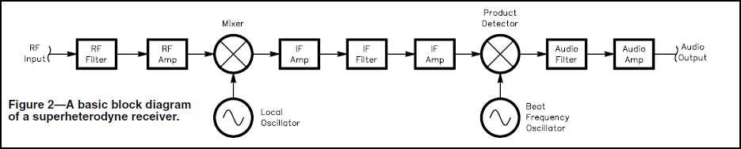
RF Oscillator
Oscillator
RF signal source
Converts dc energy into RF
Oscillator in an RF system
RF

Slide 3
Types of Oscillator Design
Multi-vibrator
Ring
Feedback
Negative Resistance

Slide 4
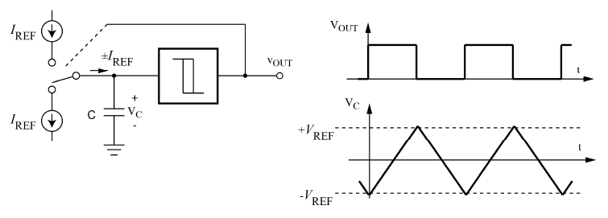
Multi-vibrator Oscillator
One or more current sources charge and discharge an energy storage element whose voltages flips a comparator (usually with hysteresis) to disconnect or connect the current source(s)
Also called astable or relaxation oscillator
Amplitude is controlled by the thresholds
Start-up is guaranteed (will always oscillate)
Usually used for low frequency (up to a few MHz)

Slide 5
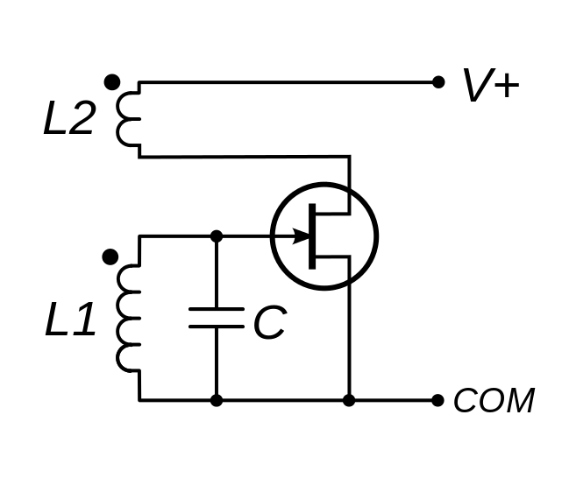
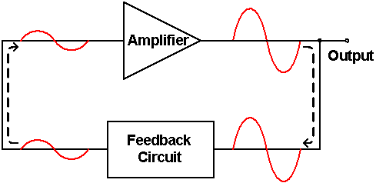
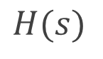
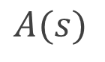
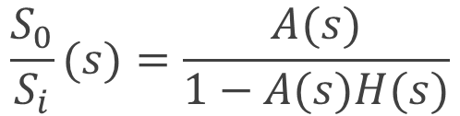
Feedback Oscillator
While in college, Edwin H. Armstrong observed high frequency oscillation if the output signal of a vacuum tube amplifier is fed back to its input; thus inventing an oscillator which could be used to generate strong signals for radio transmitters
Oscillation can be created by introducing positive feedback
Feedback
$$A(s)$$
$$\frac{S_{0}}{S_{i}}(s)=\frac{A(s)}{1−A(s)H(s)}$$
$$H(s)$$
http://en.wikipedia.org/wiki/Armstrong_oscillator
http://en.wikipedia.org/wiki/Regenerative_circuit

Slide 6
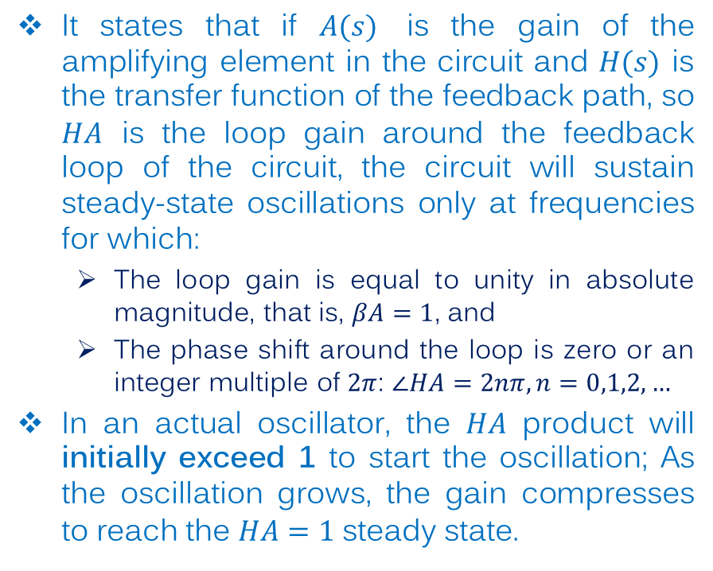
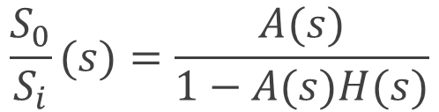
Barkhausen Criteria
It states that if $A(s)$ is the gain of the amplifying element in the circuit and $H(s)$ is the transfer function of the feedback path, so $HA$ is the loop gain around the feedback loop of the circuit, the circuit will sustain steady-state oscillations only at frequencies for which:
The loop gain is equal to unity in absolute magnitude, that is, $βA=1$, and
The phase shift around the loop is zero or an integer multiple of $2π$: $∠HA=2nπ, n=0,1,2,…$
In an actual oscillator, the $HA$ product will initially exceed 1 to start the oscillation; As the oscillation grows, the gain compresses to reach the $HA=1$ steady state.
$$\frac{S_{0}}{S_{i}}(s)=\frac{A(s)}{1−A(s)H(s)}$$

Slide 7
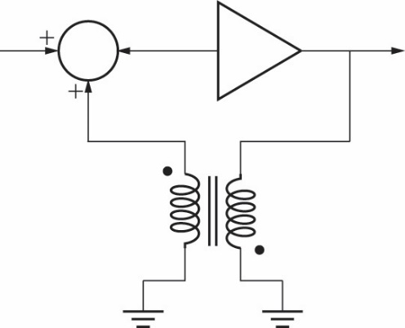
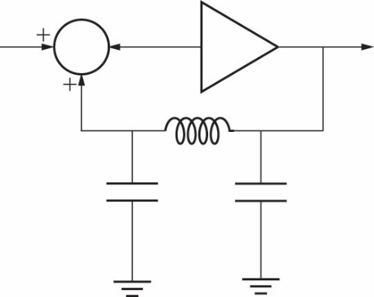
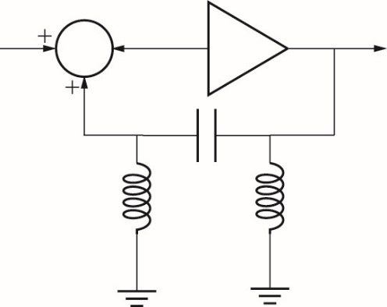
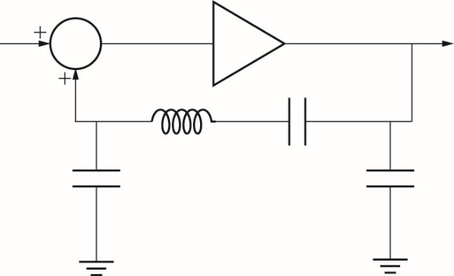
Realization of the Feedback Oscillator
A frequency selective network is usually used as the feedback network
Most oscillator designs are based on a few classic structures (templates)
Armstrong oscillator
Colpitts Oscillator
Hartley Oscillator
Clapp Oscillator

Slide 8
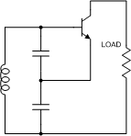
Frequency Selective Network
The frequency selective (feedback) network is usually a bandpass network whose center frequency set the correct frequency
In general, the higher the Q of the frequency selective network, the more stable the oscillation is.
The frequency selective network can be made of a variety of resonator structures
Simple L-C resonator (Q of 5 ~ 100)
Transmission line resonator (Q of 30 ~ 250)
Waveguide/Cavity resonator (Q of 300 ~ 5000)
Dielectric resonator (Q of 3000 ~ 6000)
Crystal resonator (Q of 10,000 ~ 200,000!)

Slide 9
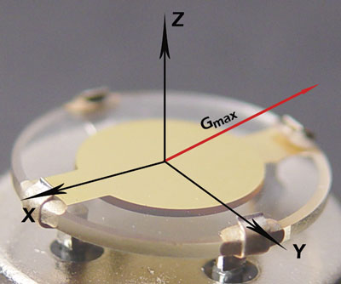
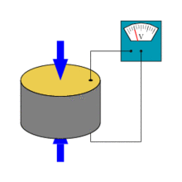
Crystal Oscillators
The “crystal” is a piece of well shaped single crystal piezoelectric material (most commonly quartz) sandwiched between two metal electrodes.
The piezoelectric effect is a property that some materials exhibit: external applied mechanical stress can induce a voltage potential and vice versa.
Quartz is a natural piezoelectric material.
The piezoelectric effect serves as a transduction mechanism, converting electric signals into mechanical vibration and back to electric signal again
The transduction is the strongest when the crystal oscillates at its natural frequency which is determined by the shape of the crystal

Slide 10
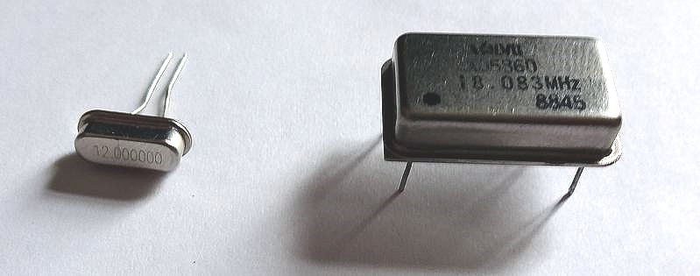
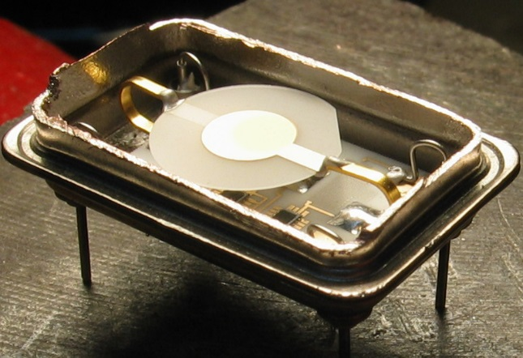
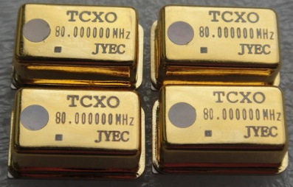
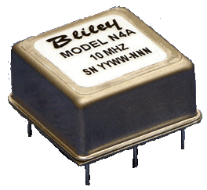
Crystal Oscillators (cont.)
Because of the extremely high Q, crystal oscillators are often used as very stable frequency sources.
The frequency of crystal oscillators are in the range of ~10 kHz to ~100 MHz.
The frequency is primarily determined by the size and shape of the crystal. The lower frequency is usually bound by the crystal size; the higher end bound by the precision of machining the crystal.
The frequency of a crystal oscillator (XO) is temperature dependent, which is an undesirable effect.
Temperature compensated crystal oscillator (TCXO) are designed carefully to reduce the temperature dependence
Oven controlled crystal oscillator (OCXO) uses active temperature control to maintain a stable temperature around the crystal for the best stability. Downside is that it burns power and needs start-up (warm-up) time.

Slide 11
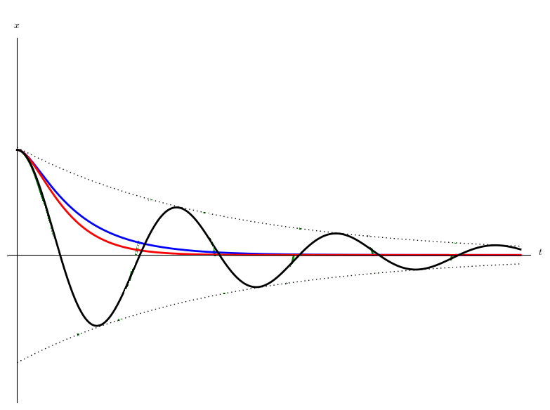
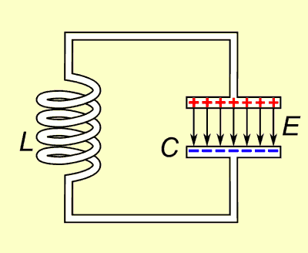
Another Oscillator Design Perspective
Let’s look at oscillation of voltage/current in a resonant circuit
The quality factor (Q) determines the damping (loss) of the system
The higher the Q, the lower the damping, the longer the oscillation lasts
In all practical systems, the oscillation eventually dies down

Slide 12
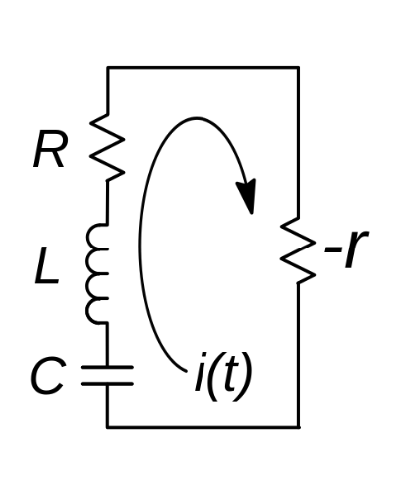
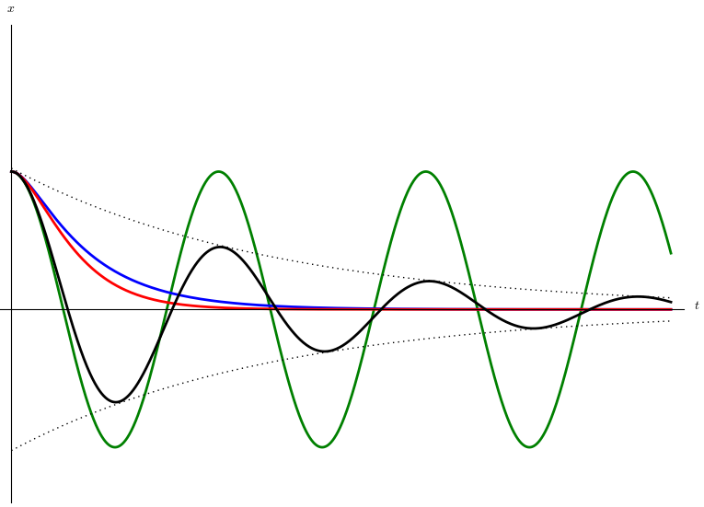
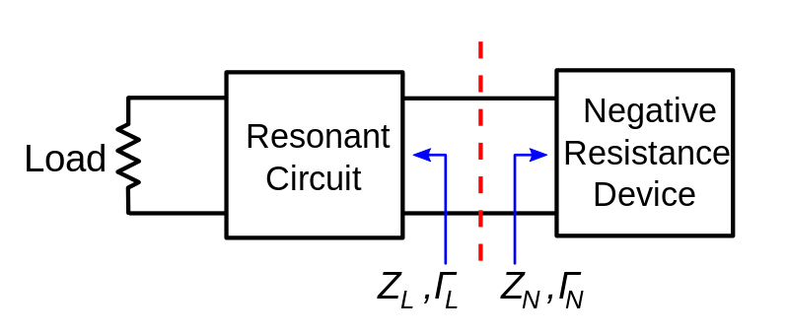
Sustaining the Oscillation – Negative Resistance
If we can replenish the dissipated energy in a resonator, we could possibly sustain the oscillation
Adding a “negative resistance” device will do the trick
A positive resistance dissipates energy; a negative resistance generates energy

Slide 13
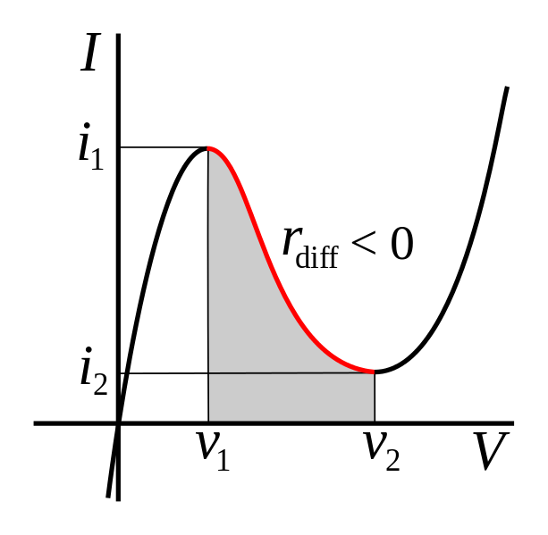
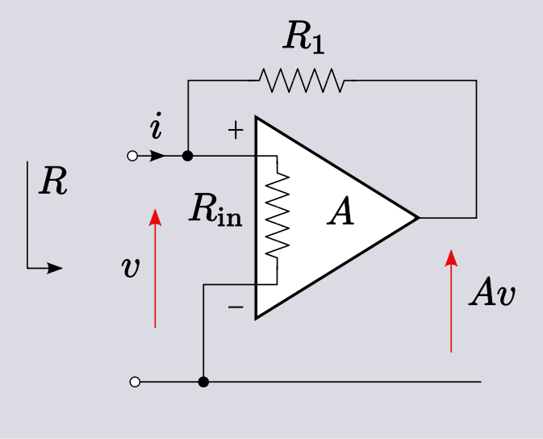
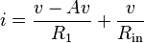
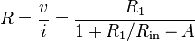
Creating Negative Resistance
How do we realize negative resistance?
I-V curves with negative slope
Positive feedback provides effective negative resistance; the idea of a negative resistance oscillator is unified with a feedback oscillator

Slide 14
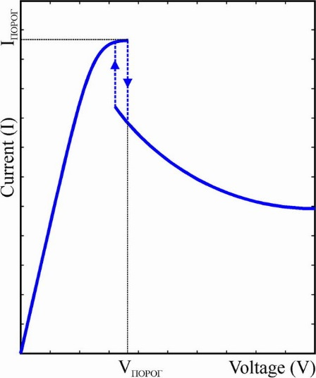
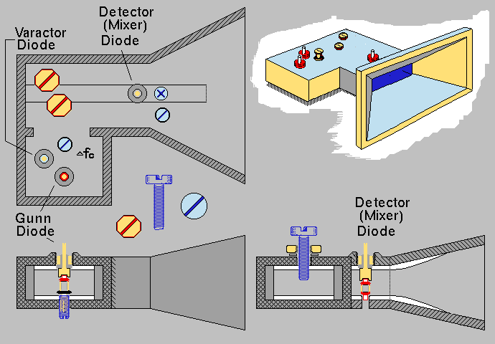
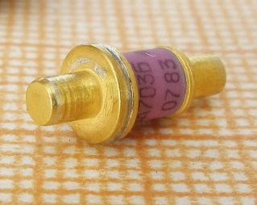
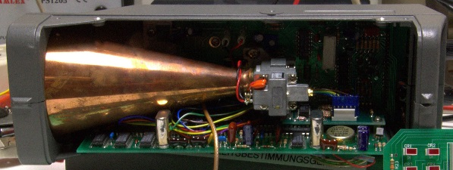
Creating Negative Resistance
How do we create negative resistance?
Some semiconductor devices exhibit negative resistance naturally; the mechanism cannot be described clearly with positive feedback
The microwave Gunn diode is a great example
Can be placed into a high-Q cavity resonator to generate oscillation
Negative I-V curve
http://en.wikipedia.org/wiki/Gunn_diode
http://www.eevblog.com/forum/projects/gunn-oscillator-doppler-radar-transceiver/

Slide 15
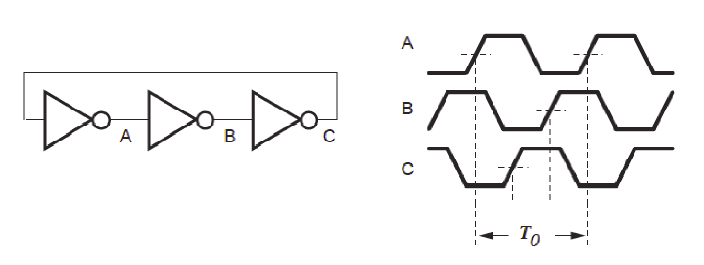
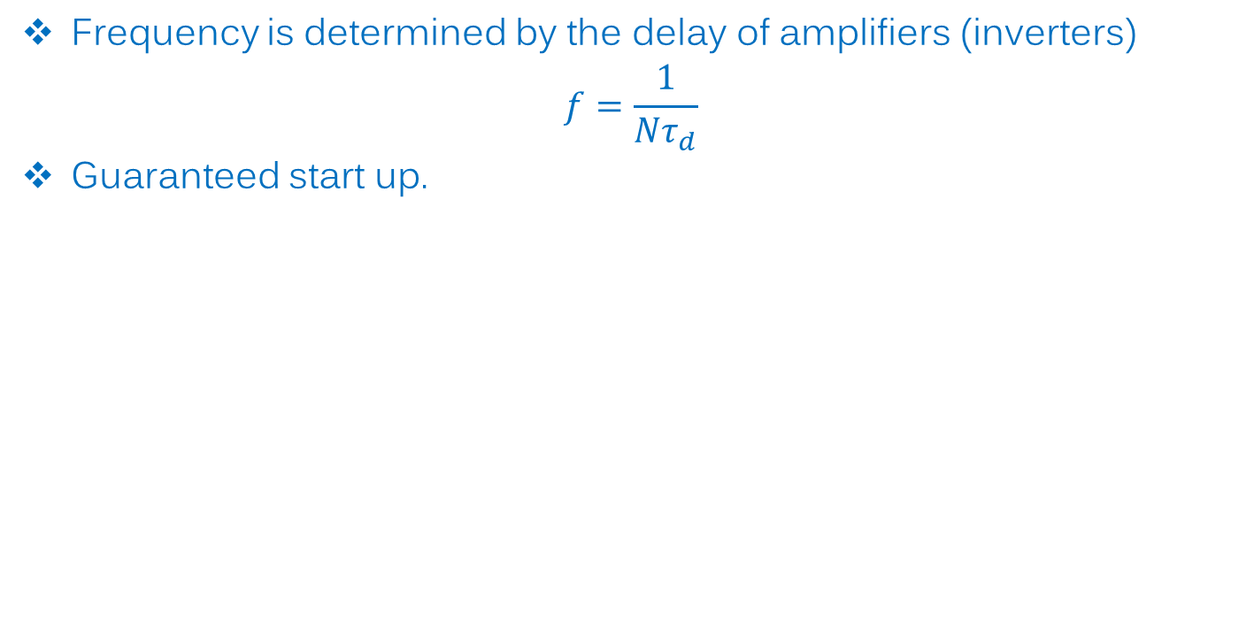
Ring Oscillator
Frequency is determined by the delay of amplifiers (inverters)
$$f=\frac{1}{Nτ_{d}}$$
Guaranteed start up.

Slide 16
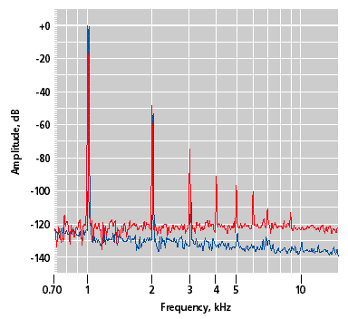
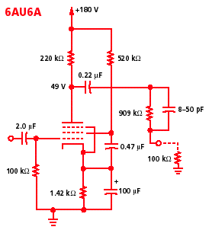
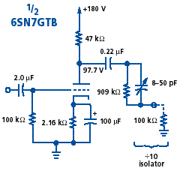
Oscillator Specifications
Output power
Some oscillators have built in buffer/driver amplifiers to improve the output power, obviously at the penalty of high dc power consumption
Harmonics
In reality, the voltage/current waveform in an oscillator is not purely sinusoidal. Some distortion is usually present, resulting in harmonic content in the output spectrum.
http://spectrum.ieee.org/consumer-electronics/audiovideo/the-cool-sound-of-tubes/3/distortion

Slide 17
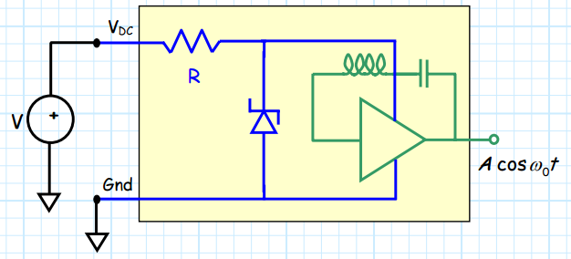
Oscillator Specifications – Pushing
In practical oscillators, the active circuit characteristics will be influenced by the supply voltage
e.g. recall that a transistor’s IV characteristics are functions of both gate (base) and drain (collector) voltages
Fluctuation in the supply voltages can result in fluctuation in the oscillator output frequency and power
Oscillator frequency pulling is specified as the frequency shift per volt change in the supply voltage: Hz/V, or Hz/mV, kHz/mV, MHz/V, or any other variants
To counteract pushing, some oscillators integrate a voltage regulator/reference
Shunt
voltage reference
http://www.ittc.ku.edu/~jstiles/622/handouts/Pushing%20and%20Pulling.pdf

Slide 18
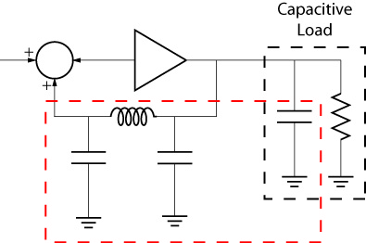
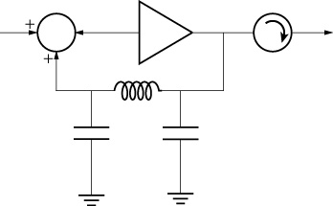
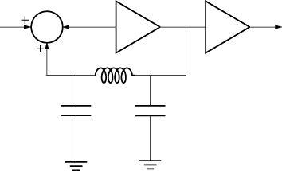
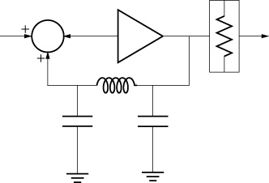
Oscillator Specifications – Pulling
The load impedance of an oscillator can also affect the oscillator output performance
e.g. consider a conceptual Collpitts oscillator shown in the left: the capacitance in the load becomes part of the frequency selective network, which may shift the resonant frequency and the output power of the oscillator. The pulling characteristics in a real oscillator may be much more complex.
Because impedance is a complex number, there is not a single quantity to quantify pulling, a typical specification could read “less than 2 MHz at VSWR = 3”; this is usually the worst-case specification.
To counteract pulling of an oscillator, the output is usually isolated from the load by an isolator/circulator, amplifier, or simply an attenuator.

Slide 19
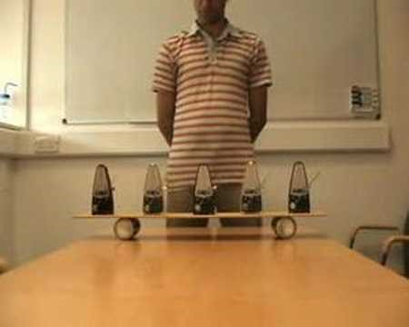
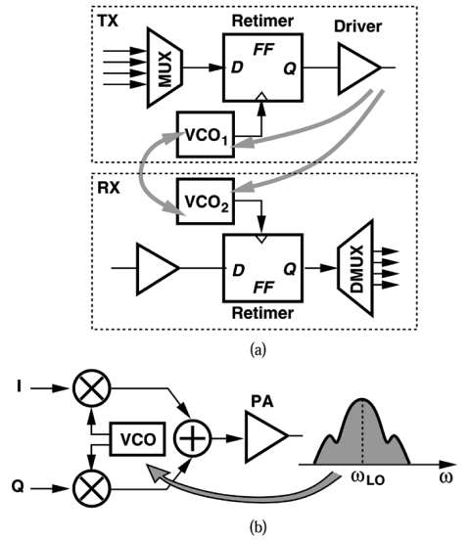
Oscillator Characteristics – Locking
When oscillators are coupled with each other, they tend to synchronize in phase and frequency
Watch a video on mechanical oscillators synchronizing in phase
Same phenomena can be observed in electronic oscillators – we call it injection locking or pulling (when the initial frequency or phase difference is too great to achieve total synchronization)
Locking can be used to our advantage
E.g. clock distribution – locking many oscillators to the same frequency reference
Unwanted locking can also be detrimental to an RF system
Synchronization of mechanical oscillators
http://ieeexplore.ieee.org/xpls/abs_all.jsp?arnumber=1327738&tag=1
Undesirable Effects of Injection Pulling

Slide 20
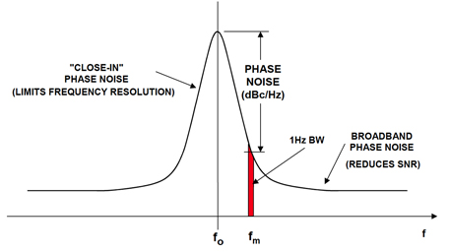
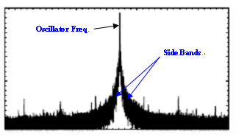
Phase Noise
Phase noise is a very important system parameter and is worth learning a little more about
Phase noise results from
imperfect frequency selectivity of the feedback network
noise sources that modulates the high frequency current/voltage that passes through the active (gain) part of an oscillator
Noise (mostly thermal) from loss components in the passive part of the circuit
Phase noise is usually specified with respect to the carrier power: dBc, in which “c” means carrier. Also, because phase noise shows itself as a continuous spectrum, its power is measured within a certain bandwidth, hence the unit of “dBc/Hz”
http://www.mti.com.tw/_english/06_center/02center.php?MainID=9&ID=57
http://www.digikey.com/en/articles/techzone/2010/dec/converting-oscillator-phase-noise-to-time-jitter

Slide 21
Phase Noise – Leeson’s Formula

Slide 22
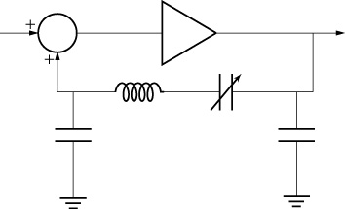
Voltage Controlled Oscillator (VCO)
An oscillator whose output frequency can be controlled by a voltage signal
Usually implemented by tuning the feedback network by a variable capacitor
Very useful component in any system whose operating frequency needs to change
FM radio
Frequency sweeping radars
Frequency synthesizers
Spectrum analyzers
Network analyzers
V_{tune}
RF

Slide 23
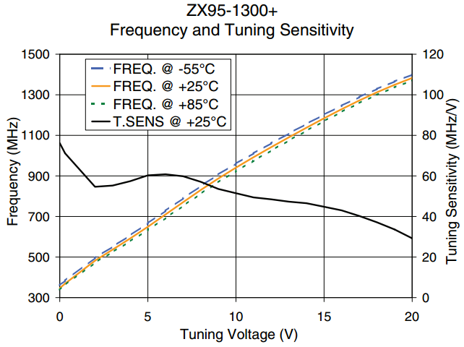
VCO Specifications
All the specifications for fixed oscillators are still applicable
Tuning sensitivity: frequency change per volt of tuning voltage change
Sometimes referred to as “VCO gain”
Specified in Hz/V, or MHz/V
A higher sensitivity means that you can cover a large frequency range with small tuning voltage; it also means that the output frequency is more sensitive to the noise in the tuning voltage
In some applications, particularly frequency modulation (FM) systems, tuning linearity is of particular concern
Good linearity ensures good modulation fidelity
Mini-Circuits

Slide 24
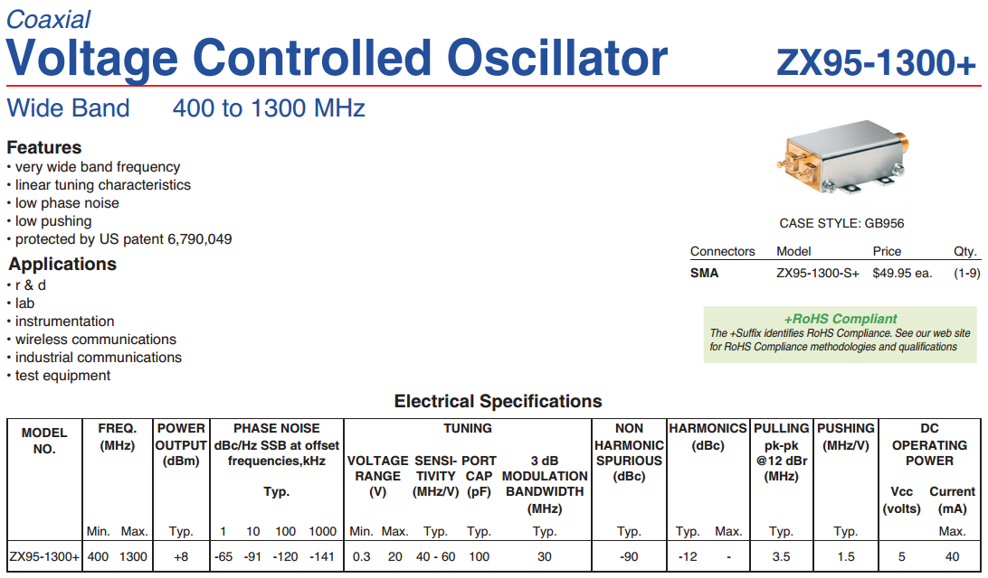
Example VCO Datasheet
Mini-Circuits ZX95-1300+

Slide 25

Example VCO Datasheet (cont.)

Slide 26




Example VCO Datasheet (cont.)

Slide 27

Example VCO Datasheet (cont.)

Slide 28


Phase-Locked-Loop (PLL)
A feedback loop to achieve very high frequency stability and low phase noise
Also a very useful technique to accurately track the frequency and phase of the input signal
Crystal frequency
reference
Read more: http://www.analog.com/library/analogDialogue/archives/33-03/phase/index.html

Slide 29

Phase Detector
K_{PD}
Transfer function
XOR as a simple implementation
http://www.seas.ucla.edu/brweb/teaching/215C_W2013/PLLs.pdf

Slide 30


Modeling the VCO
Assuming that the VCO has a linear tuning characteristics and its sensitivity/gain is K_{VCO}
A higher frequency means faster phase progression
http://www.seas.ucla.edu/brweb/teaching/215C_W2013/PLLs.pdf

Slide 31


Phase/Frequency Detector and Charge Pump
The phase detector (PD) detects the phase difference between the two incoming signals and output a voltage/current that is proportional to this difference
A phase frequency detector (PFD) maintains correct output even when the input signal frequency is different

Slide 32


Example
The PFD allows the use of charge-pump circuits to create the control signal for the VCO
Low-pass filter smooths out the pulses
VCO
Increase in V_{cont} (V_{TUNE}) bumps up the frequency and therefore the phase progression so that the VCO output phase can catch up with the V_{in} (V_{ref}) phase
http://www.seas.ucla.edu/brweb/teaching/215C_W2013/PLLs.pdf

Slide 33

Phase/Frequency Detector
The phase/frequency detector (PFD) provides the correct output even when the frequencies of the two inputs are different
http://www.seas.ucla.edu/brweb/teaching/215C_W2013/PLLs.pdf

Slide 34


PFD+ Charge Pump (CP) in PLL
The charge pump provides the current to drive the subsequent stage in the PLL
The PLL locks the output signals phase and frequency to the reference: we can now replicate the stability and low phase noise of the reference!
PFD
LPF
CP
http://www.seas.ucla.edu/brweb/teaching/215C_W2013/PLLs.pdf

Slide 35


Phase Noise in a PLL
A PLL is basically a negative feedback look that stabilizes the output signal to the reference.
The stabilization only takes effect within the loop bandwidth—effectively the bandwidth of the low-pass filter.
http://www.analog.com/library/analogDialogue/archives/33-05/phase_locked/index.html
http://electronicdesign.com/analog/adc-performance-what-s-jitter-got-do-it

Slide 37


Frequency Synthesis – Integer-N Synthesizer
The basic PLL studied above isn’t very useful for frequency synthesis; the output signal frequency is the same as the reference!
Adding a divide by N block:
Output frequency now a multiple of the reference frequency
By digitally controlling the divider ratio N we can generate different frequencies
Drawback: Output frequency resolution is determined by the reference frequency
One penalty paid is the phase noise: Phase noise grows 6 dB per multiple by 2, or 20 dB per multiple by 10, in frequency
$$f_{out}={N×f}_{REF}$$
http://www.seas.ucla.edu/brweb/teaching/215C_W2013/Synthesizers13.pdf

Slide 38


Integer-N Synthesizer – Adding a Reference Counter
A reference counter can improve frequency resolution
Drawback: the reference counter R makes the feedback counter very large!
Example:
Using a 10 MHz reference clock and a reference counter of 1,000, we can achieve frequency resolution of 10 kHz
To get an output frequency around 900 MHz, we’d need a N value of 90,000 -> equivalent of a 17-bit counter, difficult to make it working right at high frequency
$$f_{out}=\frac{{N×f}_{REF}}{R}$$
Mark Curtin and Paul O’Brien, “Phase-Locked Loops for High-Frequency Receivers and Transmitters,” Analog Dialogue 33-3, 1999

Slide 39


Integer-N Synthesizer – Prescalar
Adding a pre-scalar to alleviate the issue: the division is now done in two steps
The pre-scalar is a high-frequency component that divide the feedback signal by a fixed ratio, e.g. /2, /4, /8, /32, etc
Because P is fixed, the frequency resolution degrades by P ! Now we seem be going in circles!
Fortunately P is usually much smaller than R, so we still get a net gain
And another clever solution exists to solve this issue
$$f_{out}=\frac{{PN×f}_{REF}}{R}$$
Mark Curtin and Paul O’Brien, “Phase-Locked Loops for High-Frequency Receivers and Transmitters,” Analog Dialogue 33-3, 1999

Slide 40


Integer-N Synthesizer – Dual Modulus Prescalar
Counter A and counter B time-outss sequentially to toggle the prescalar value by 1
Both A and B can be digitally controlled
$$f_{out}=\frac{{(BP+A)×f}_{REF}}{R}$$
Mark Curtin and Paul O’Brien, “Phase-Locked Loops for High-Frequency Receivers and Transmitters,” Analog Dialogue 33-3, 1999

Slide 41


Fractional-N Synthesizer
Fractional-N synthesizer shifts the modulus of the divider randomly to achieve lower phase noise
It also achieves greater frequency resolution and faster switching time
And it’s too complicated for this class, so we won’t discuss it further.
Mark Curtin and Paul O’Brien, “Phase-Locked Loops for High-Frequency Receivers and Transmitters,” Analog Dialogue 33-3, 1999

